Slide 1

website
Student name: Ilwad Abdi
ID number:22014624

Slide 2

databases

Slide 3
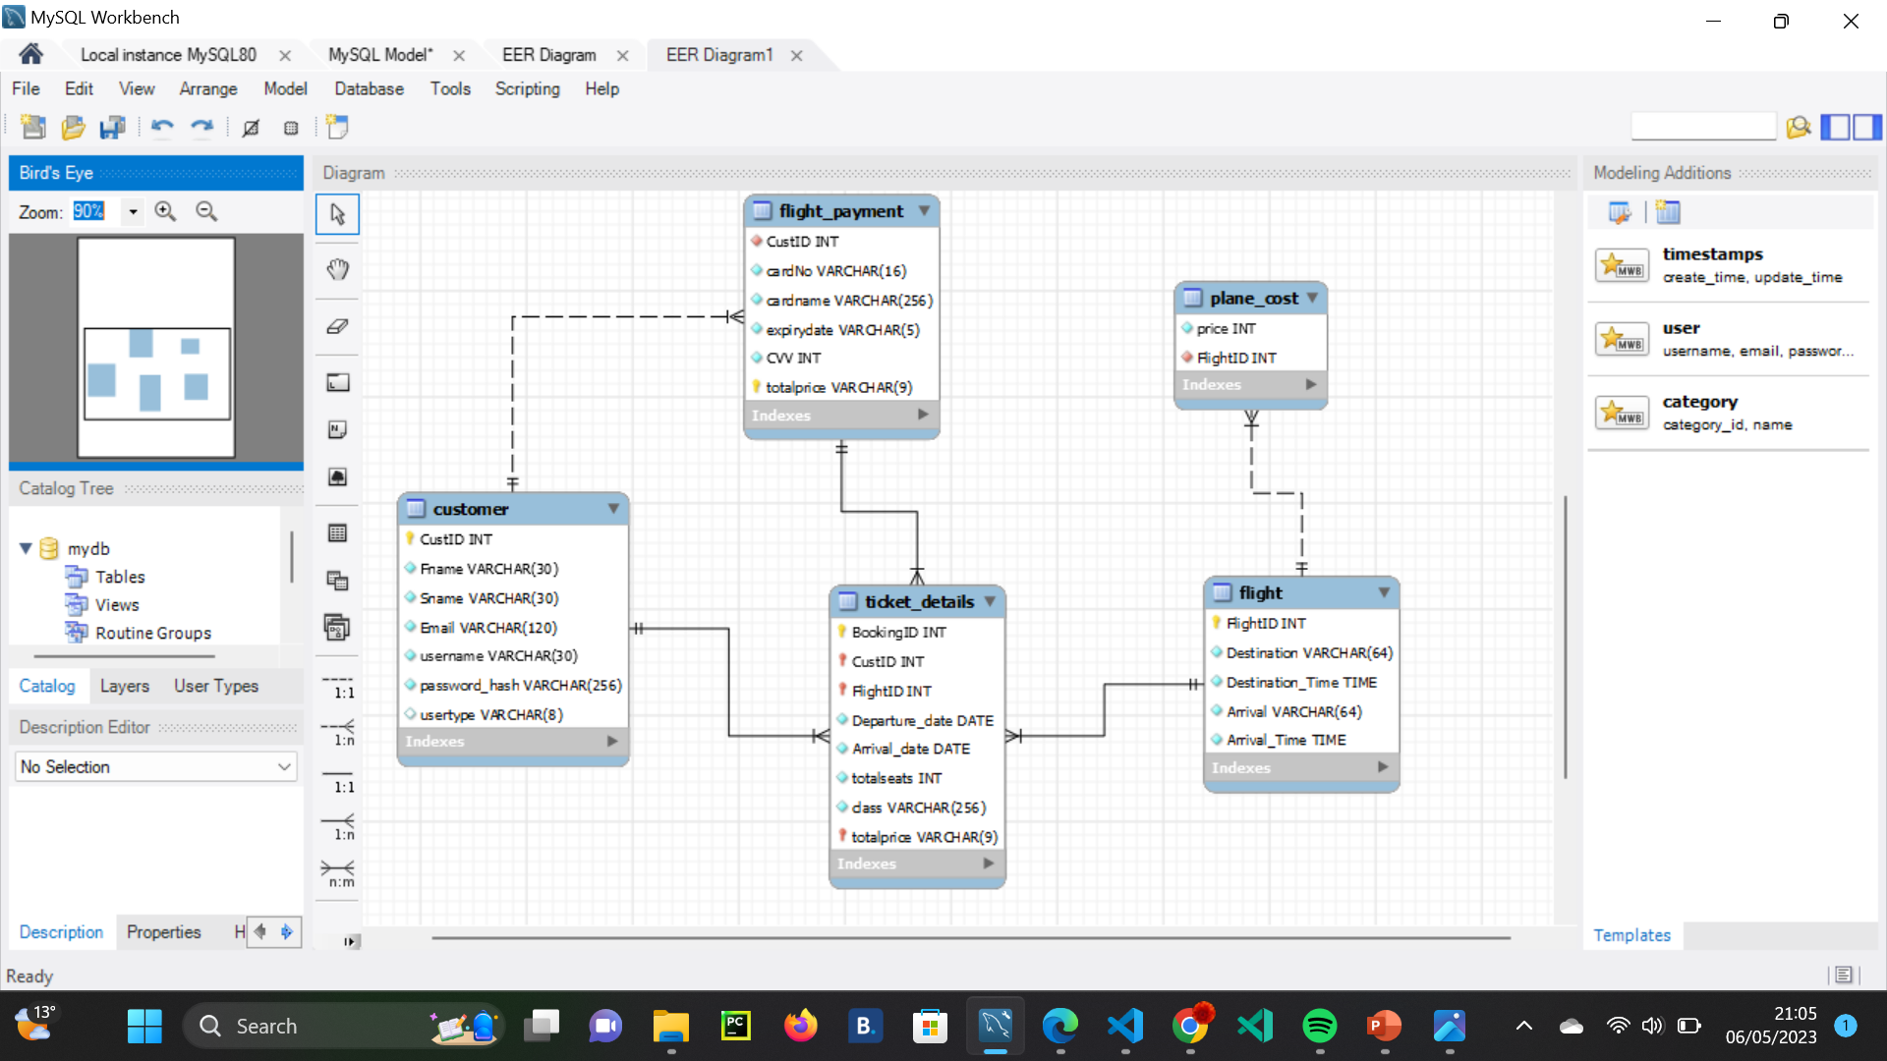
ERD

Slide 4
UNORMALISED TO 1NF
Each columns should single values in them not multiple values.
They all have unique names .
No repeating characteristics so new columns are made. For example, Name would be split into first name and last name columns.

Slide 5
1NF to 2NF
Each table would have a primary key
Creating foreign keys to relate to other tables
Partial dependencies have been eliminated in all tables by splitting them into multiple tables. For instance, the ticket details for bookings were separated from the customer table.

Slide 6
2NF to 3NF
To ensure the absence of transitive dependencies, I created two separate tables .One table dedicated to routes, where flightID is a primary key. The other table for prices, where flightID is used as a foreign key to make a link.

Slide 7

LESP ASPECTS

Slide 8
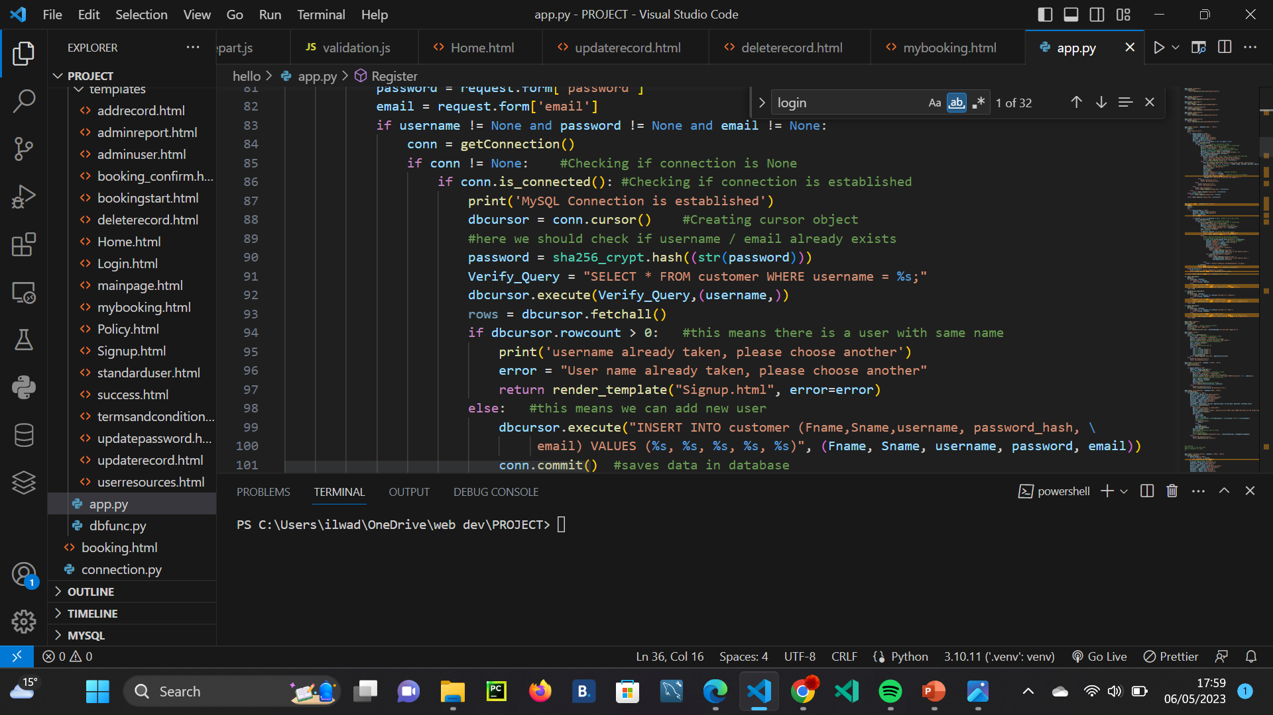
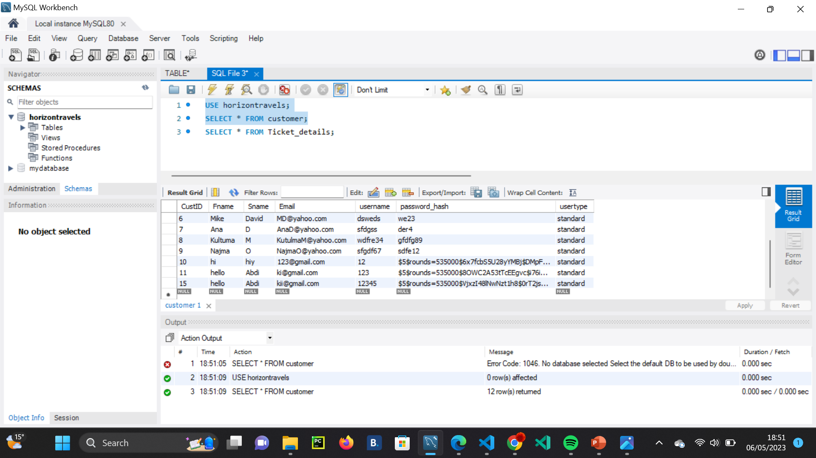
Legal aspects
Privacy policy added on the policy page.
Terms and conditions on the policy page
Encrypted the password using sha256_crypt when signing up (in case of data breach)
To see their own bookings , their customer ID is used so not just anyone sees their booking details.
Only Admin selected in database would have access to all the records .
Privacy policy was in guidelines of GDPR law.

Slide 9
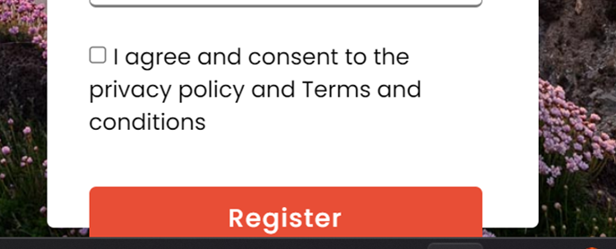
Ethical aspects
Privacy policy states how customer’s data is collected and how is stored .
Customer can view this and terms and conditions on policy page.
Data consent -When signing up, they would need to agree to the privacy policy and terms and conditions.
Customer would not be able to continue unless the checkbox is checked. Terms and conditions are on the policy page.

Slide 10
Social aspects
Made the website accessible for all people with disabilities. Text is readable and big in size for all customers.
Website used mobile-first approach so users can view on computer , tablet and mobile phone.

Slide 11
Professional Aspects
Website was tested with other colleagues and friends.
All functions work at full capacity.
There is a theme throughout the website which creates a nice feel .
Design and layout- have a theme throughout the website. Images used for different locations.

Slide 12
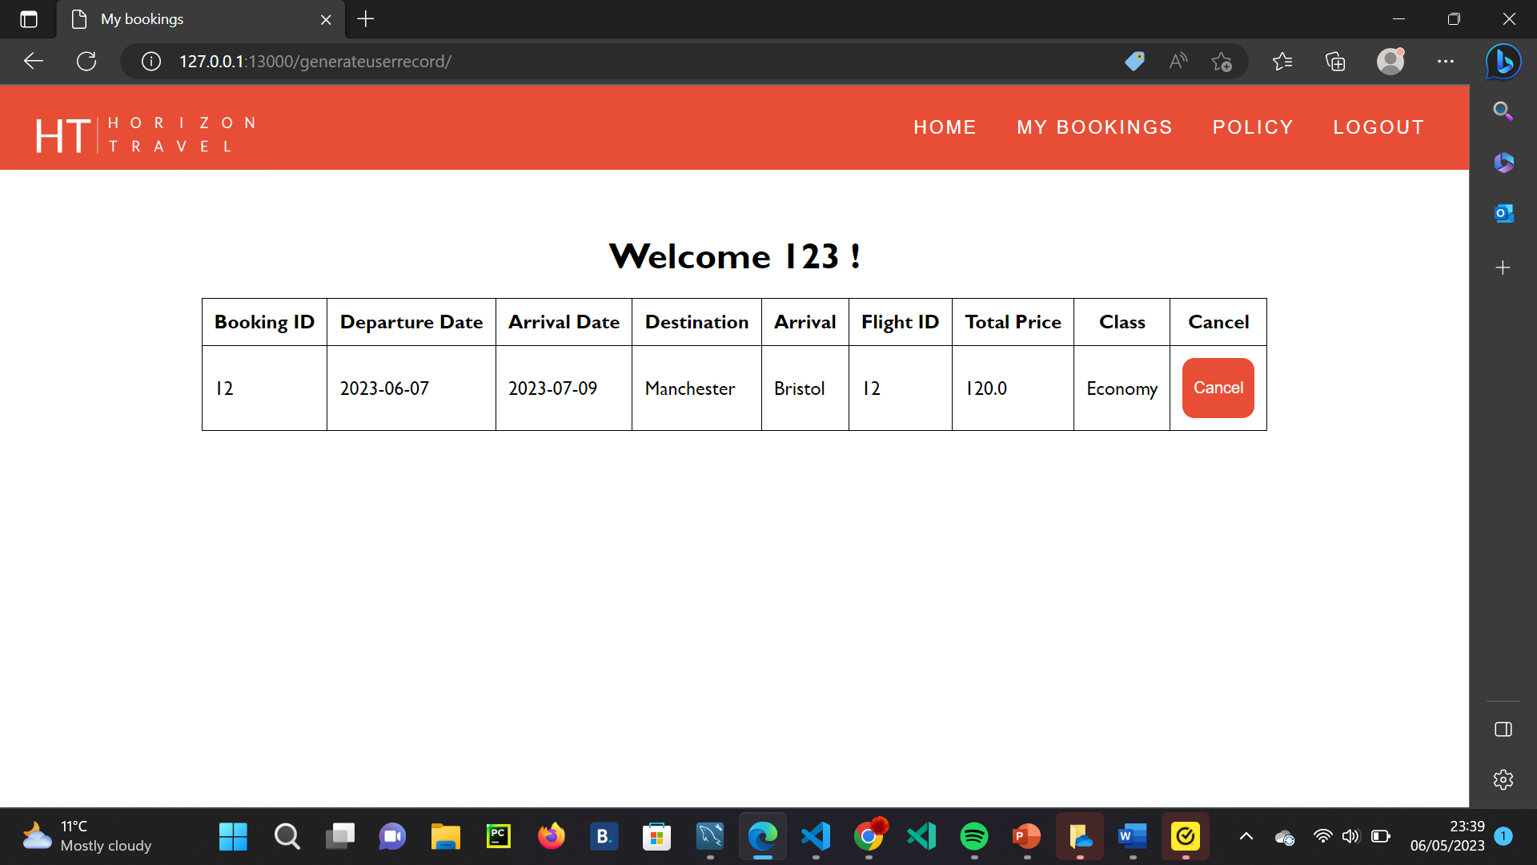
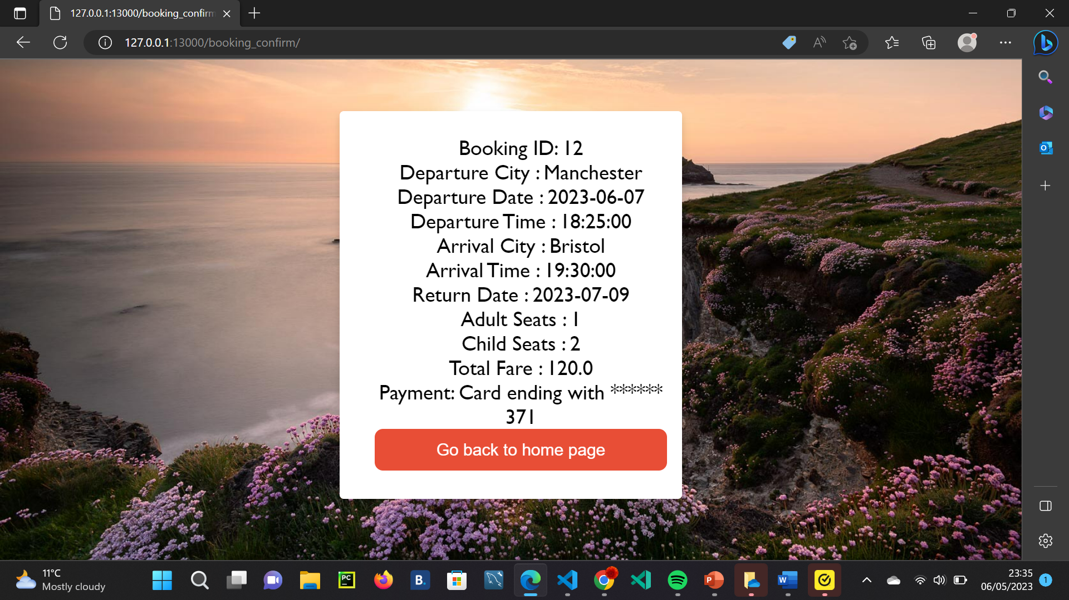
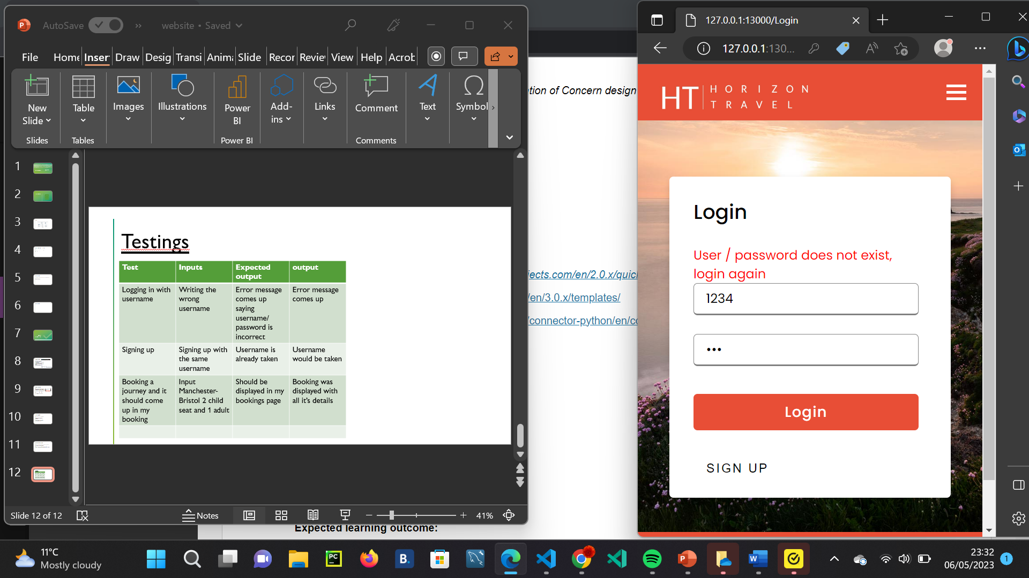
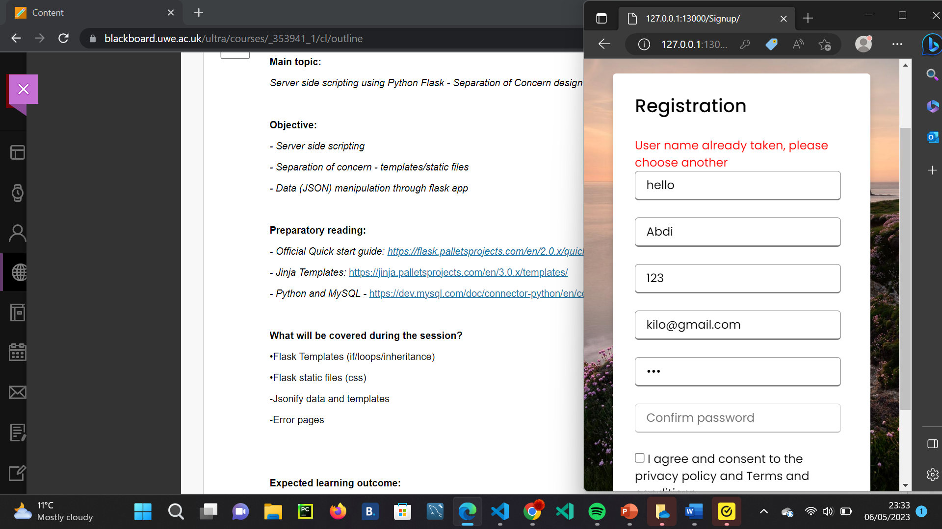
Testings
Test | Inputs | Expected output | output
Logging in with username | Writing the wrong username | Error message comes up saying username/ password is incorrect | Error message comes up
Signing up | Signing up with the same username | Username is already taken | Username would be taken
Booking a journey and it should come up in my booking | Input Manchester-Bristol 2 child seat and 1 adult | Should be displayed in my bookings page | Booking was displayed with all it’s details

